Slide 1
Control Board RS-232 to PAX Case

Slide 2
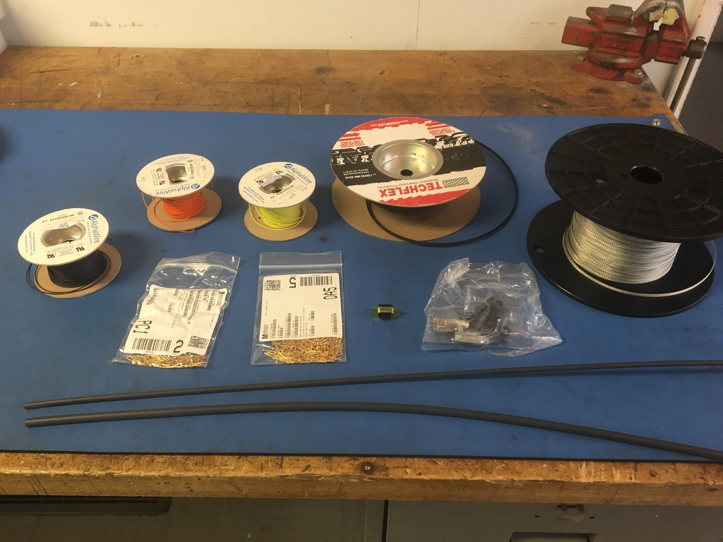
Materials

Slide 3
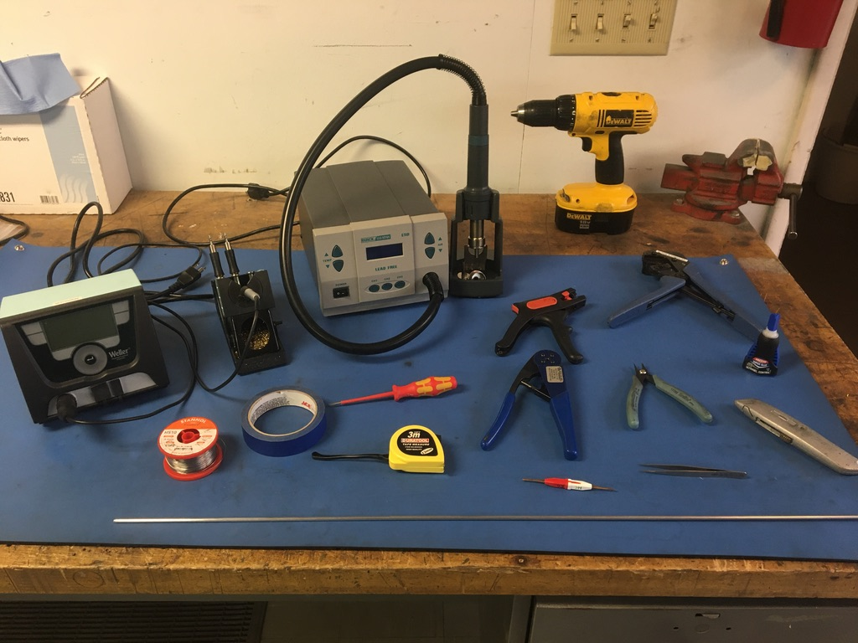
Tools

Slide 4
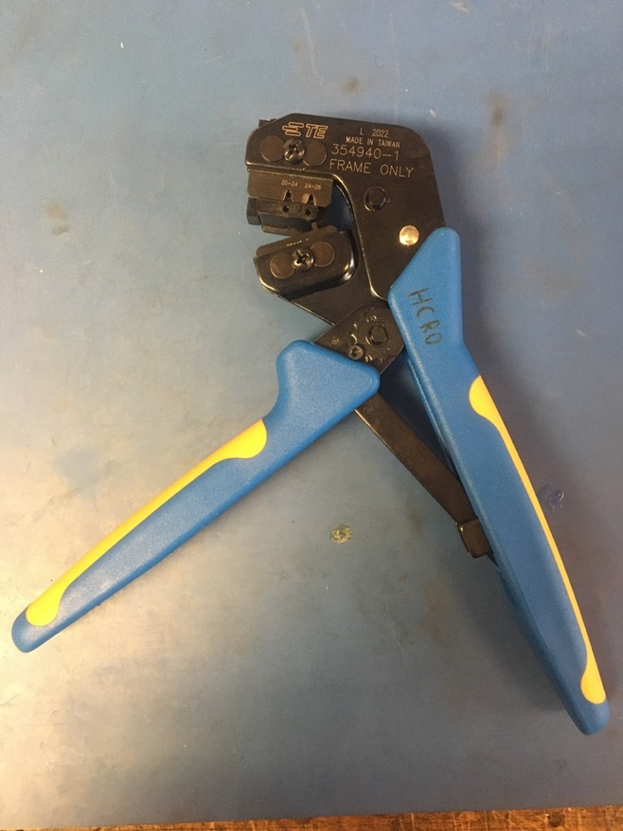
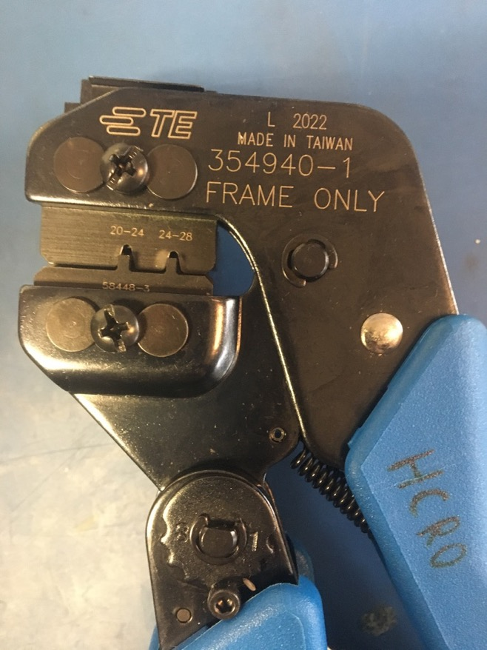
D Sub Crimp Tool

Slide 5
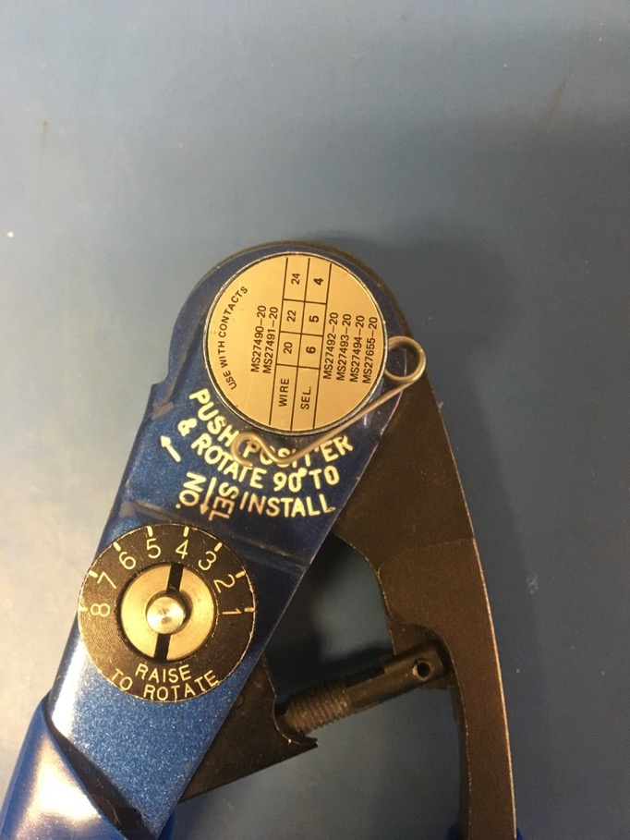
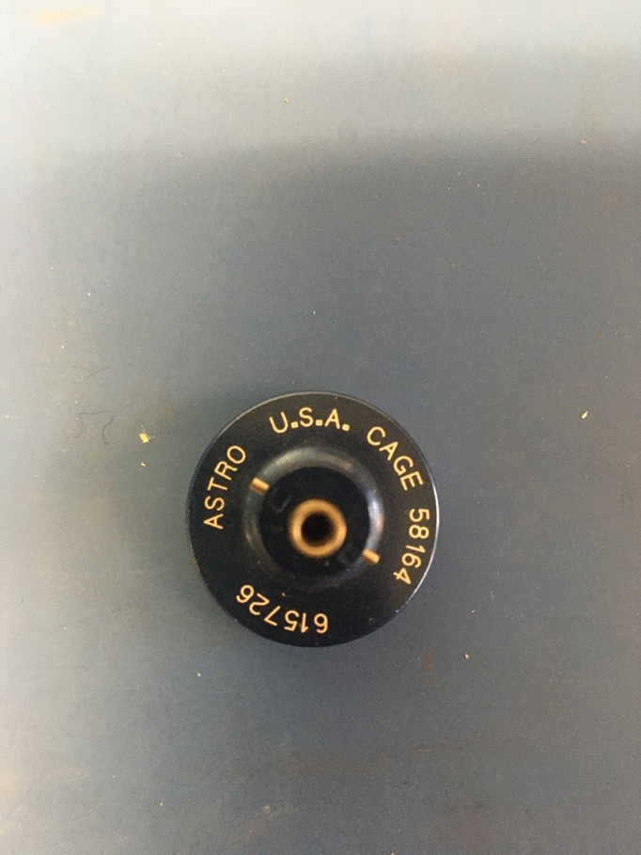
MIL Spec Crimp Tool

Slide 6
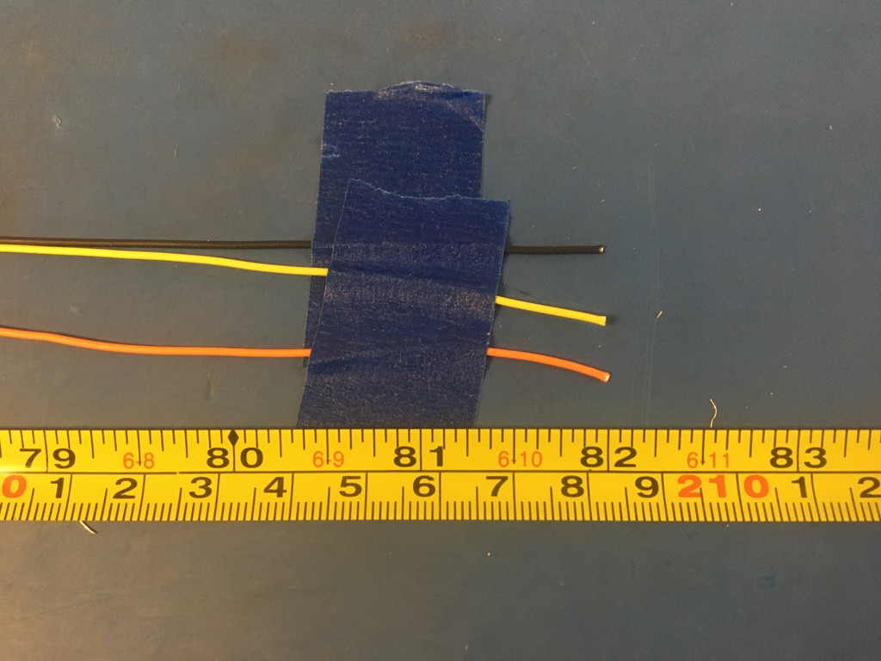
Measure out and cut 82 inches of yellow, orange, and black 24 awg wire.

Slide 7
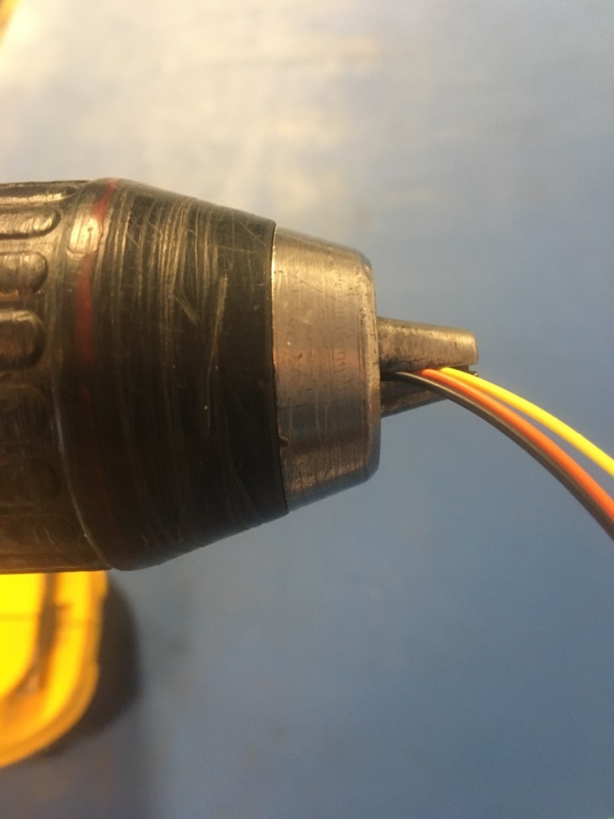
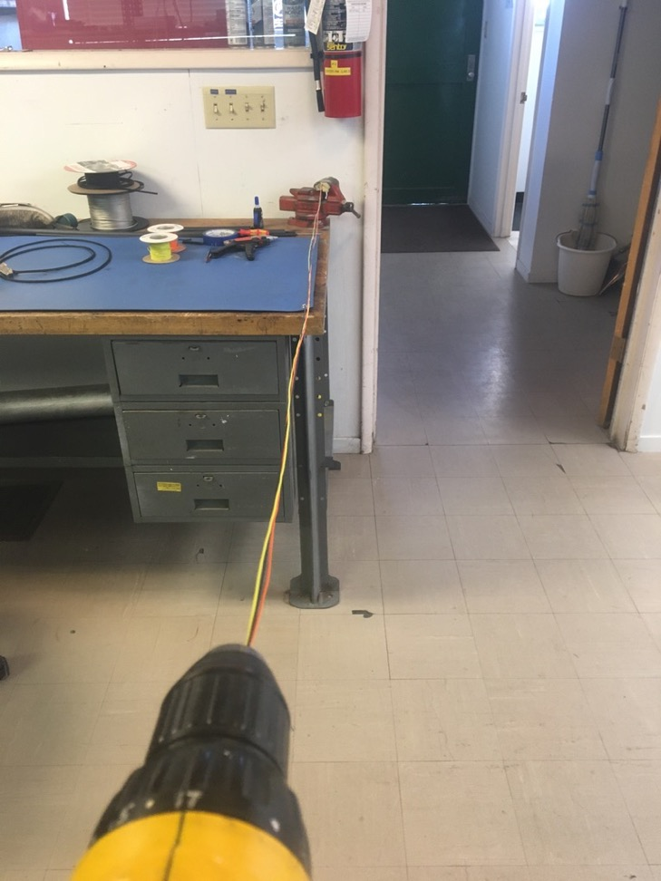
To make the twisted triplet, line the vise with masking tape. Put one end of the yellow, orange, and black wires into the vise and the other into the drill. Run the drill till the wires are sufficiently twisted (for reference see the next slide).

Slide 8
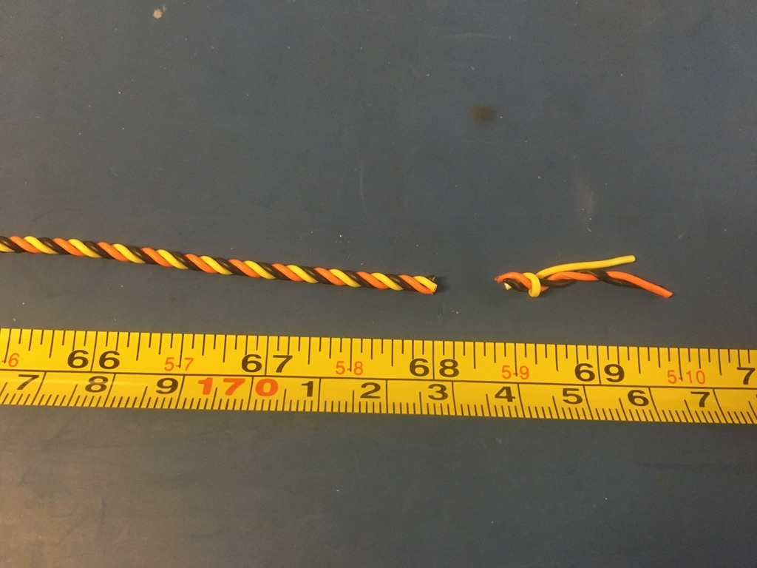
Trim the ends of the twisted triplet where they were in the vise and drill. Once trimmed it should measure about 68 inches.

Slide 9
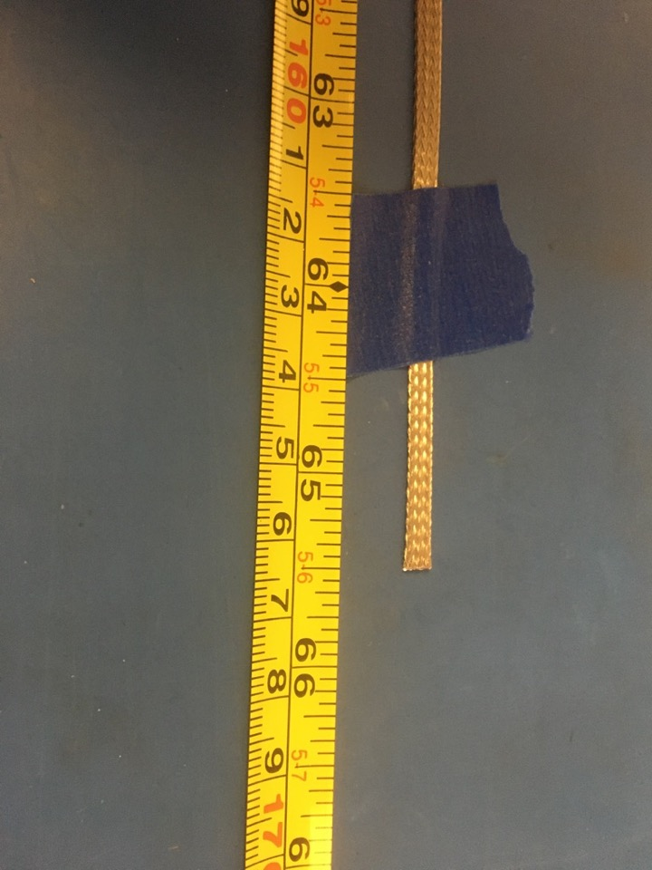
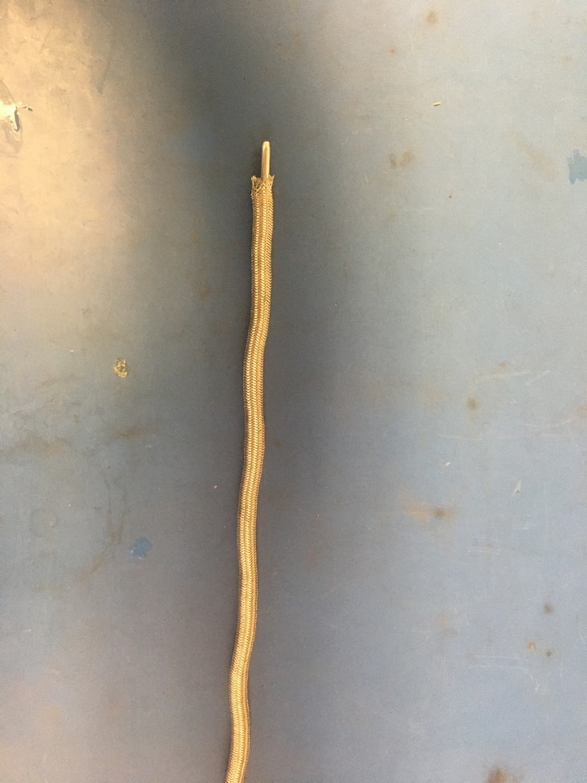
Measure out 65.5 inches of the 1/8th metal braid. Expand it using the metal rod.

Slide 10
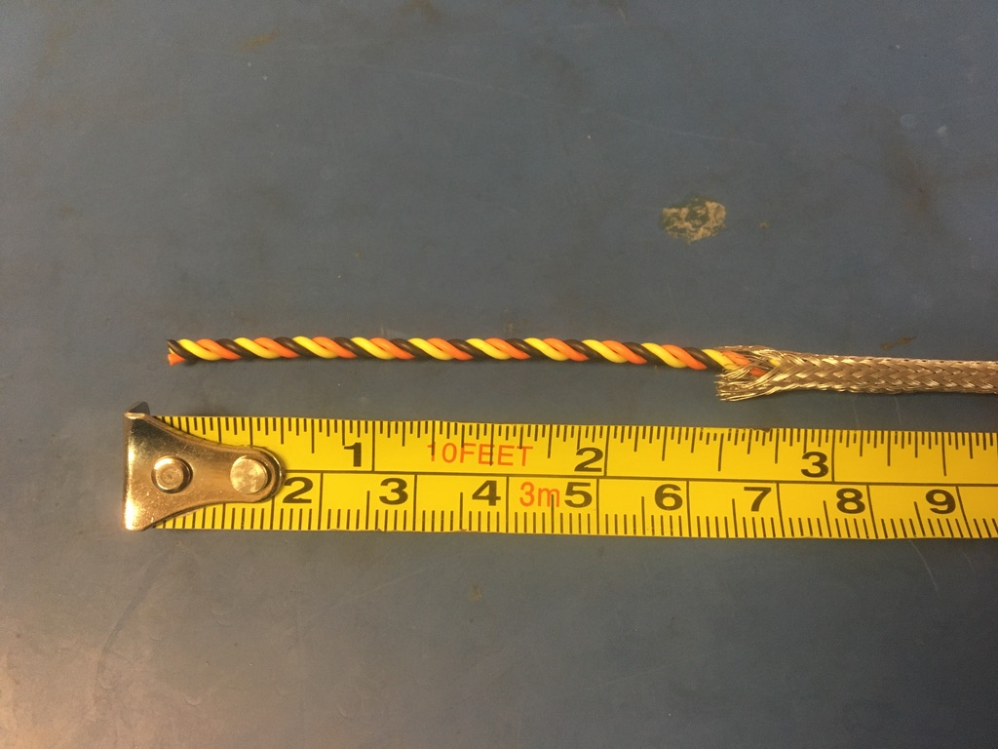
Put the twisted triplet into the expanded metal braid. 2.5 inches of the twisted triplet should stick out from the metal braid on one end.

Slide 11
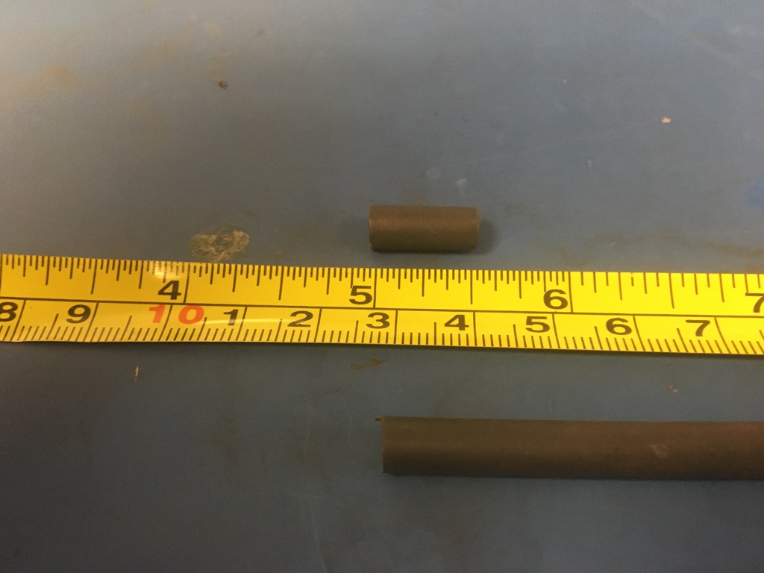
Measure out and cut two lengths of 4.8mm adhesive shrink tube each .5in long.

Slide 12
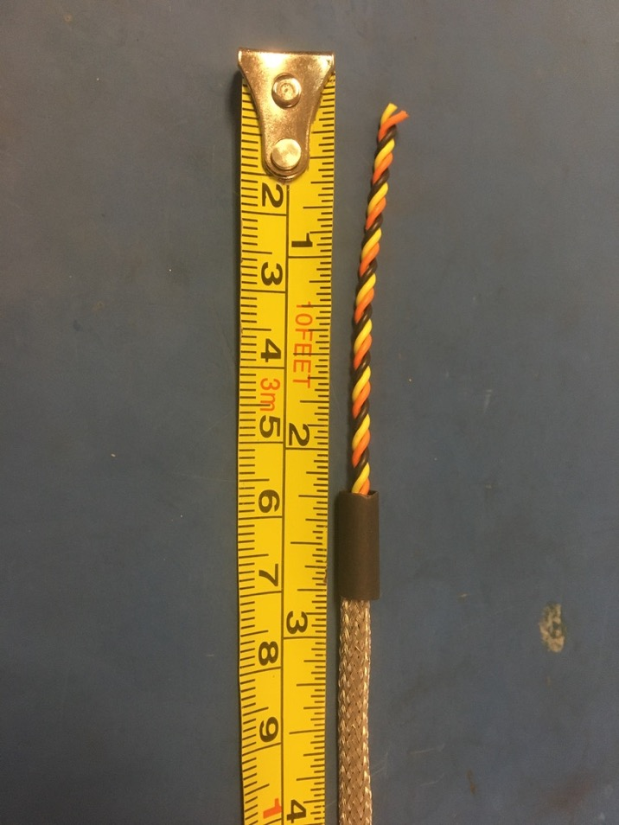
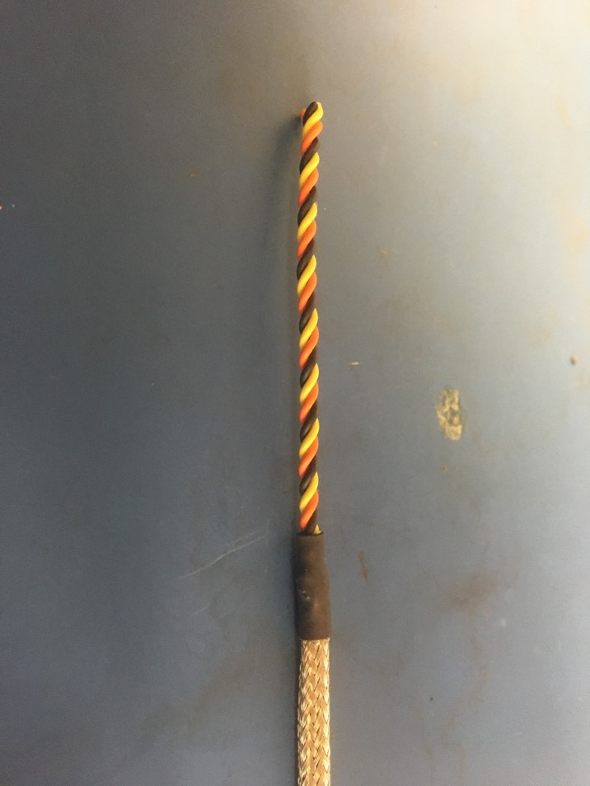
Put one of the pieces of the shrink tube onto the end of the metal braid where the wires measured 2.5 inches. Place the shrink tube such that the metal braid ends midway through it. The wires should now measure 2.25 inches long. Apply the heat gun to the shrink tube.

Slide 13
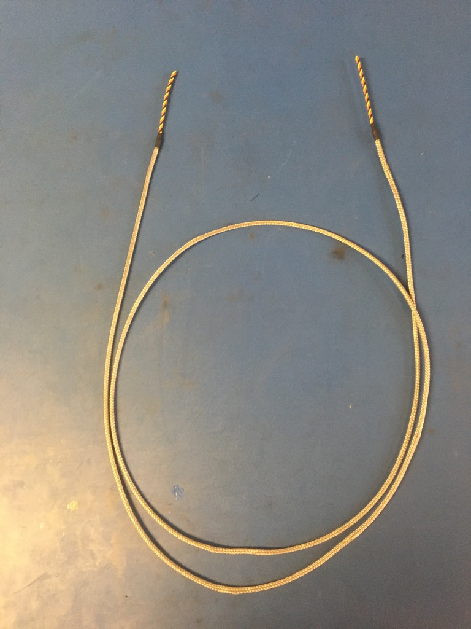
Repeat the process on the previous slide on the other end of the metal braid (though the wire does not need to be measured this time). Thus far, the wire harness should appear as shown on the left.

Slide 14
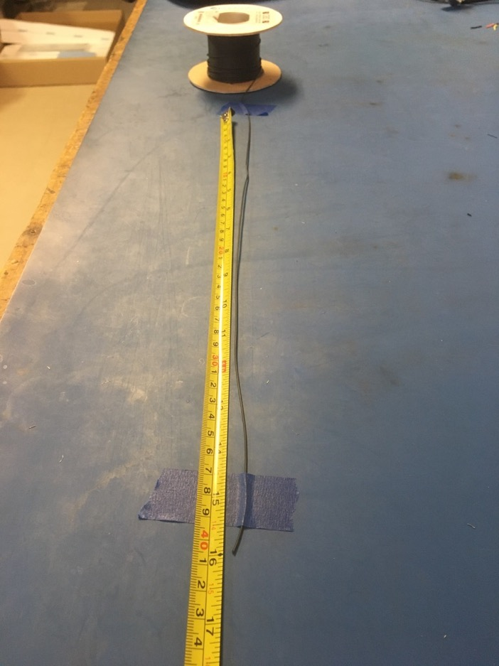
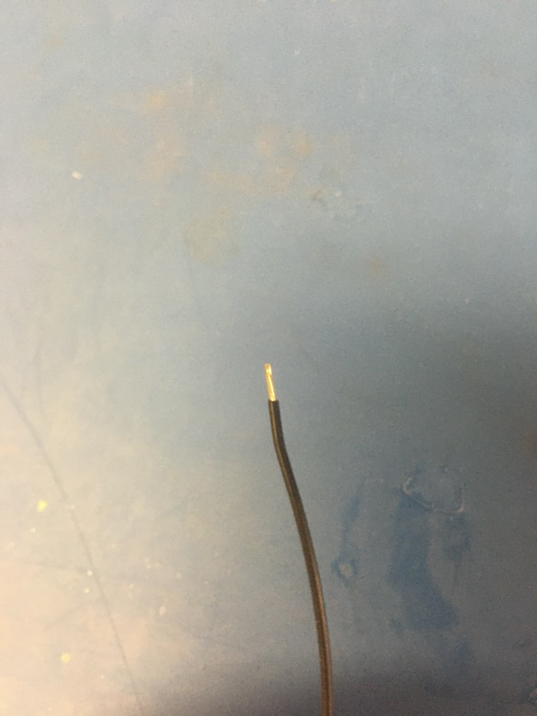
Measure out and cut 16 inches of black 24 awg wire. Strip 3-4mm off one end.

Slide 15
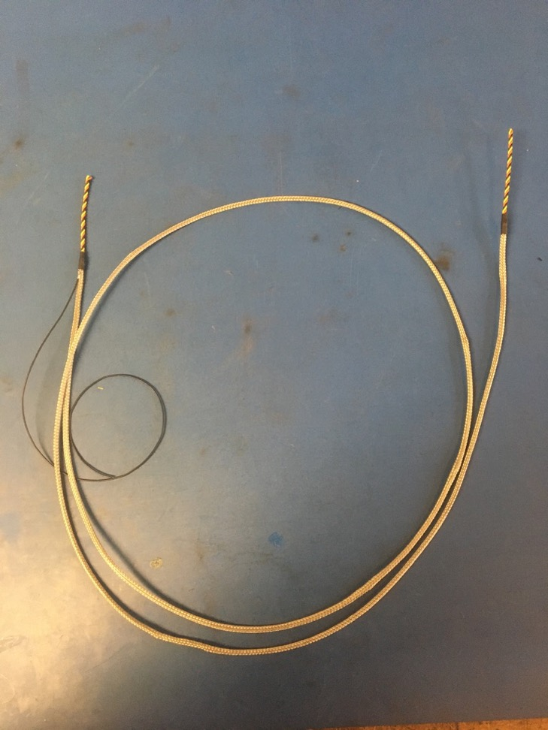
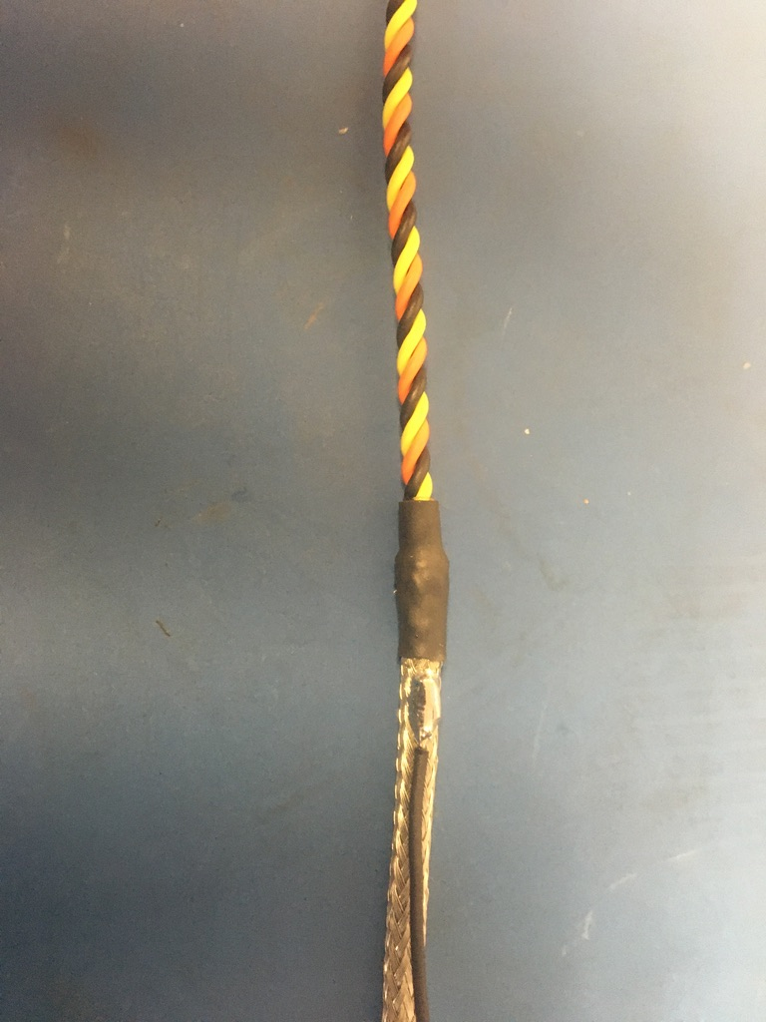
Solder the stripped end of the black wire onto the metal braid near the shrink tube joint with the shorter length of wire (the end that was measured to be 2.25 inches). The black wire should be soldered so the that its length runs with that of the metal braid.

Slide 16
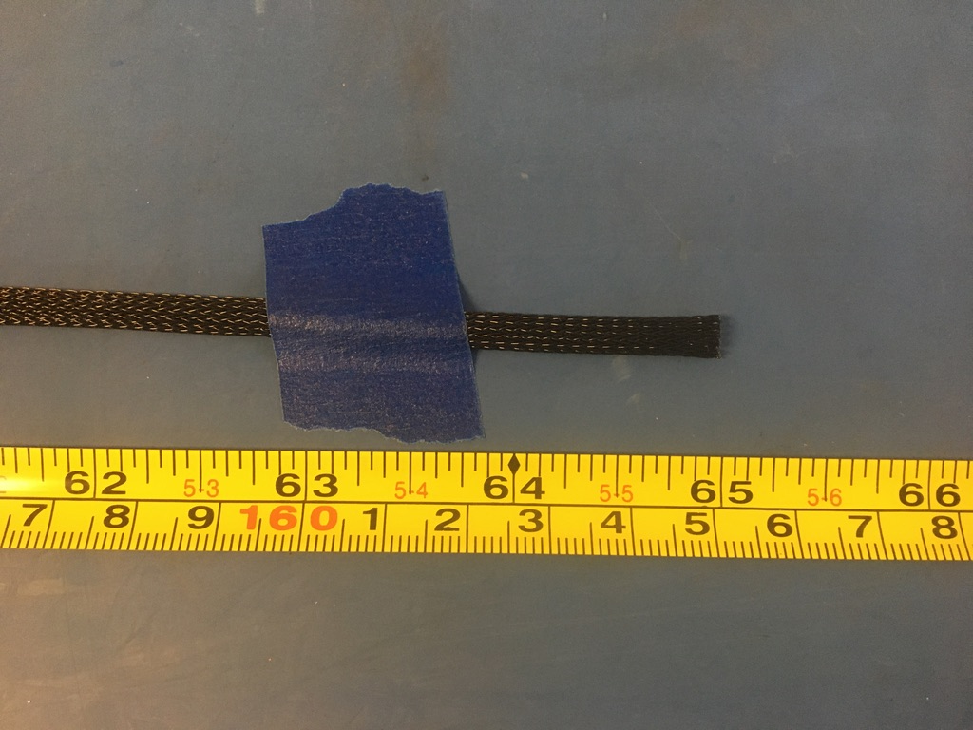
Measure out and cut 65 inches of 1/4th plastic braid.

Slide 17
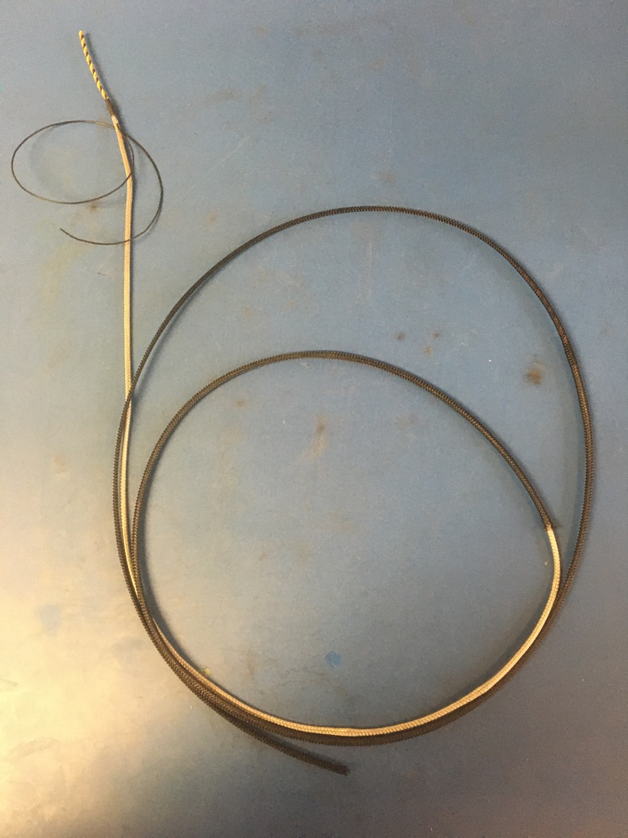
Put the plastic braid onto the wire harness. It does not matter from which end.

Slide 18
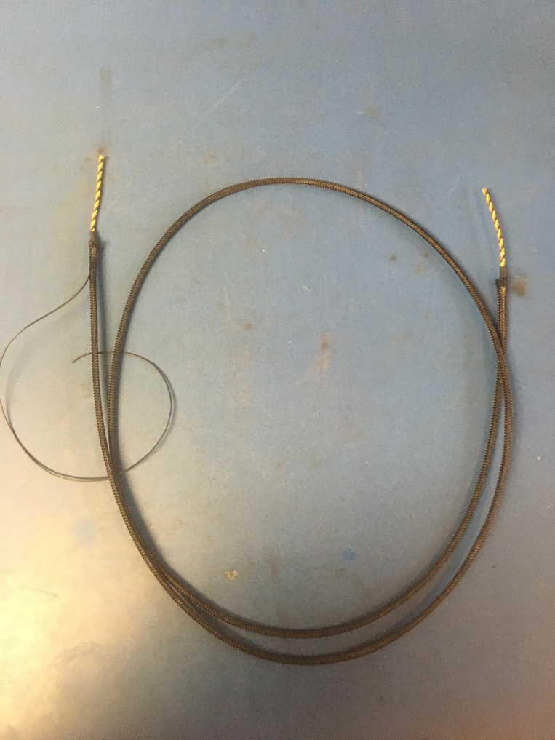
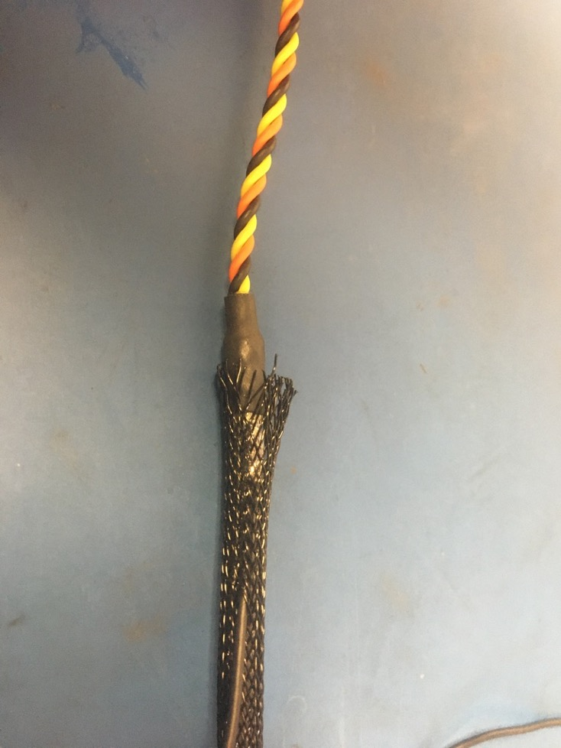
Thread the ground wire through one of the holes in the plastic braid so it appears as shown of the left. At each end of the harness, the plastic braid should end midway through the metal shrink tube joints.

Slide 19
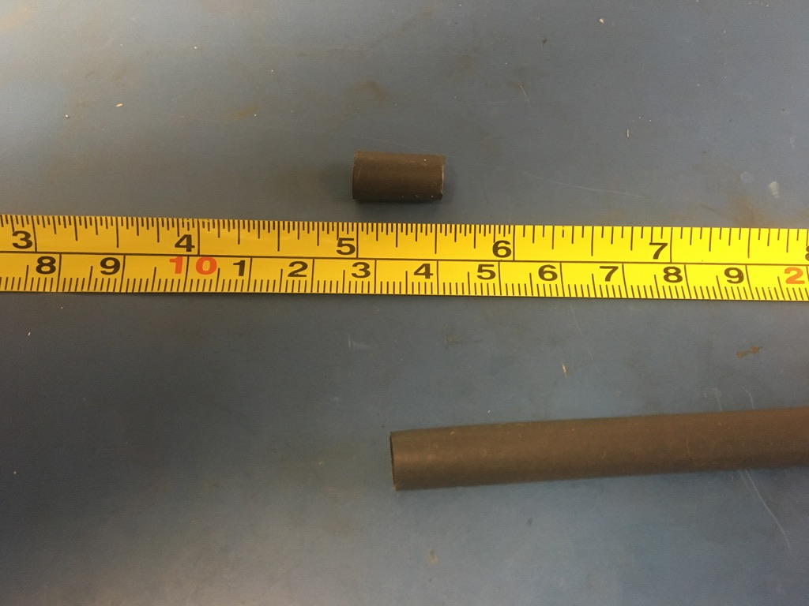
Measure out and cut one length of 6.4mm adhesive shrink tube that is .5in long.

Slide 20
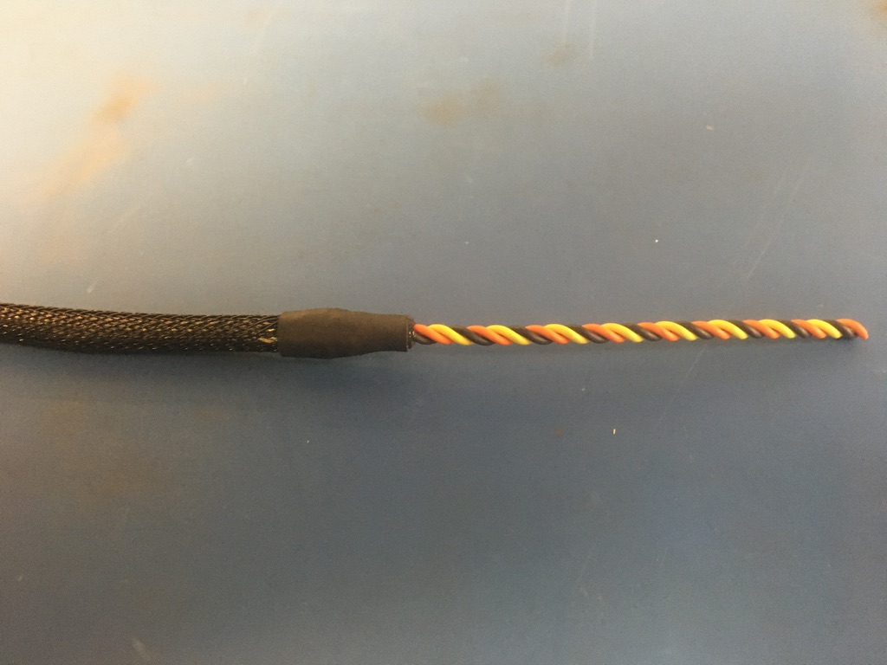
Place the piece of shrink tube onto the plastic braid end without the ground wire. The plastic braid should end midway through the piece of shrink tube. Apply the heat gun.

Slide 21
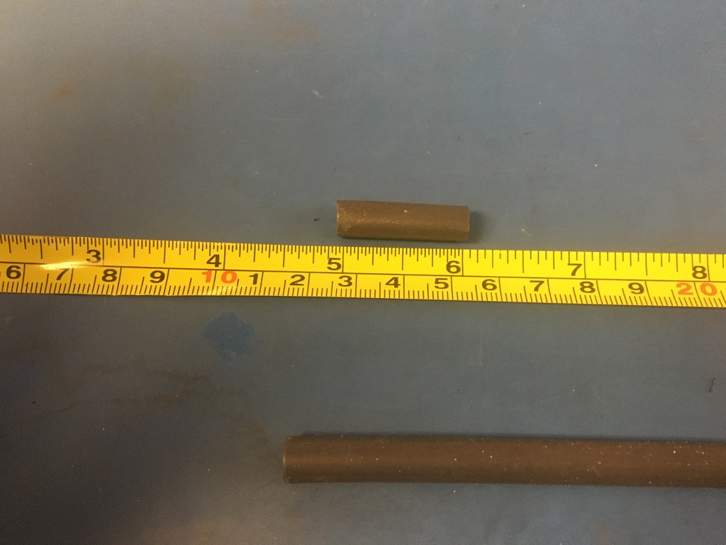
Measure out and cut one length of 6.4mm adhesive shrink tube that is 1in long.

Slide 22
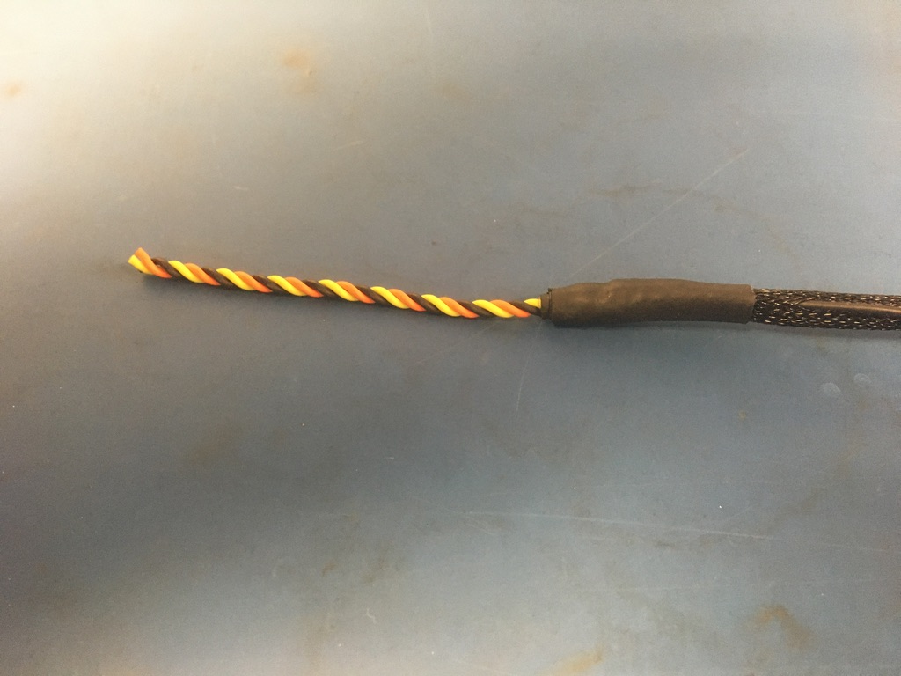
Place the piece of shrink tube onto the ground wire end of the harness. The shrink tube should be placed such that it covers the solder joint and the length of the metal braid shrink tube. Apply the heat gun.

Slide 23
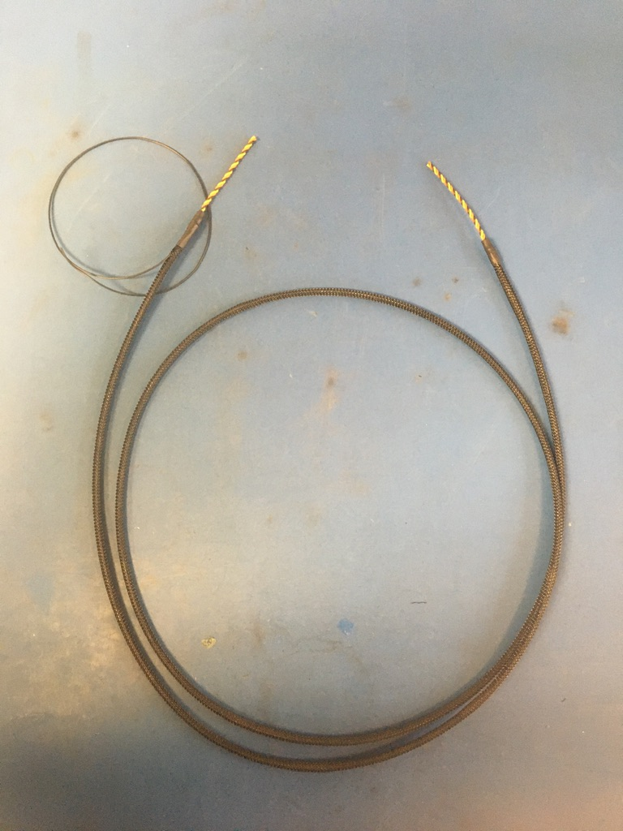
So far, the wire harness should appear as shown on the left.

Slide 24
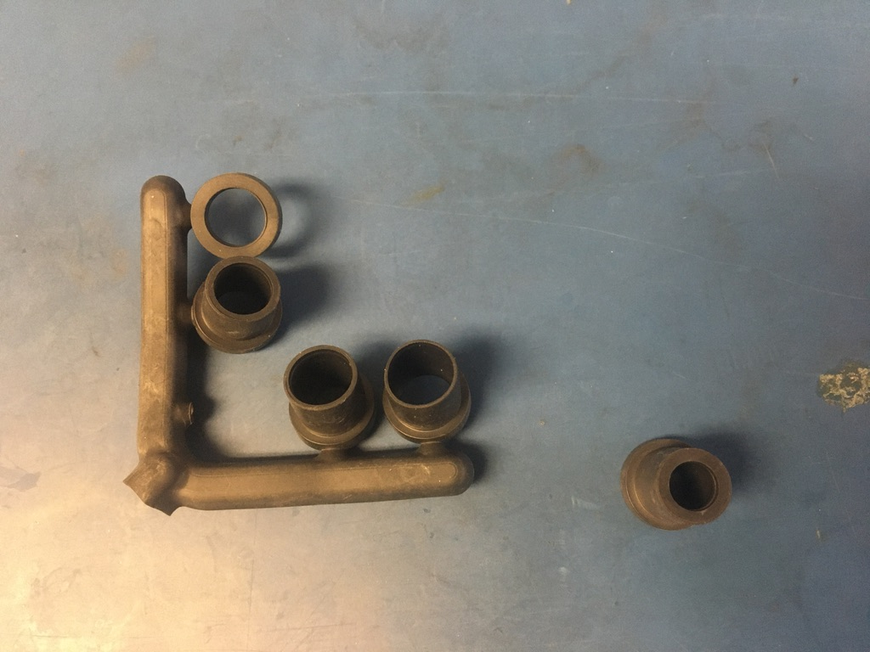
Select the D-sub shell stop. If using a new D-sub shell, the smallest size is appropriate. However, if reusing an old D-sub shell, use the smallest size available. Test the D-sub shell stop on the ground wire end of the wire harness. If the fit is loose, layer shrink tube until the fit is more snuggly.

Slide 25
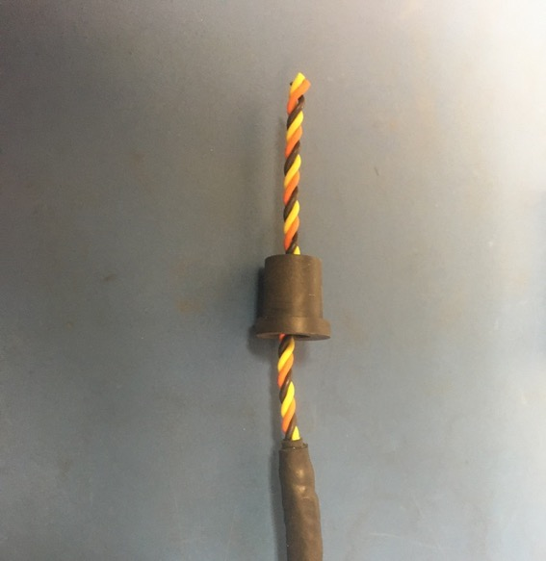
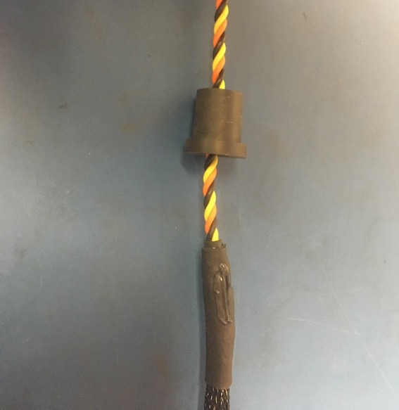
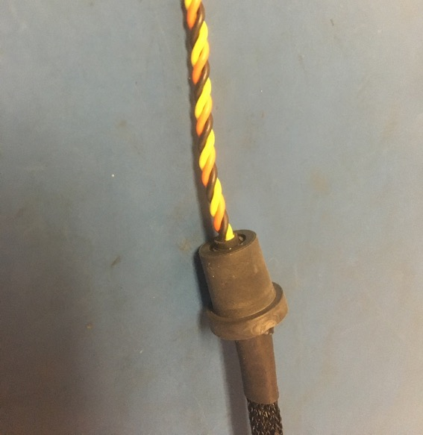
Once any additional shrink tube is added, thread the D-sub shell stop onto the end without the ground wire and apply super glue to the end of the shrink tube as shown. Put the D-sub shell stop over the super glue and twist it around to spread the super glue inside the stop. The final position of the D-sub shell stop is as shown on the right: with stop’s end flush with end of the shrink tube.

Slide 26
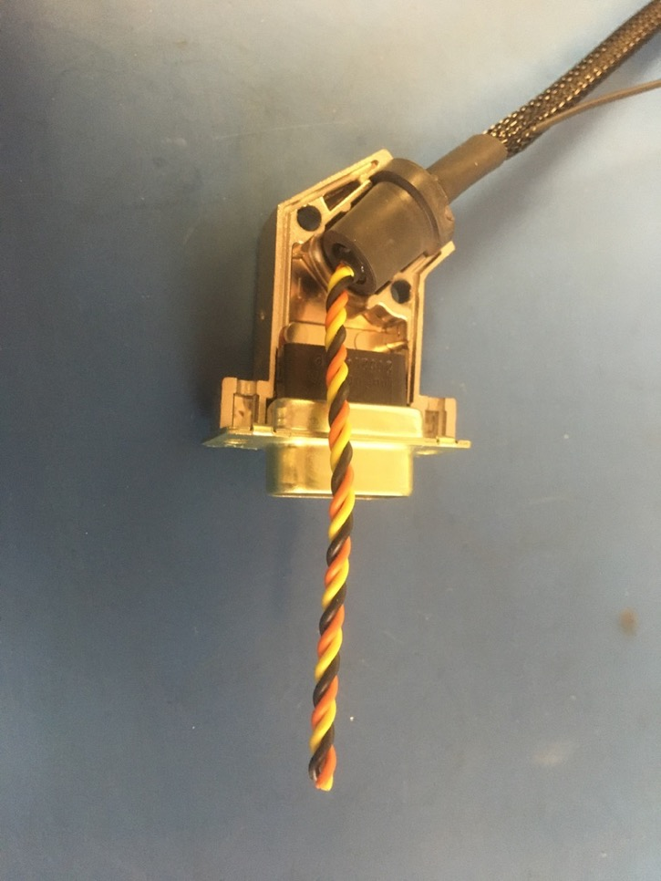
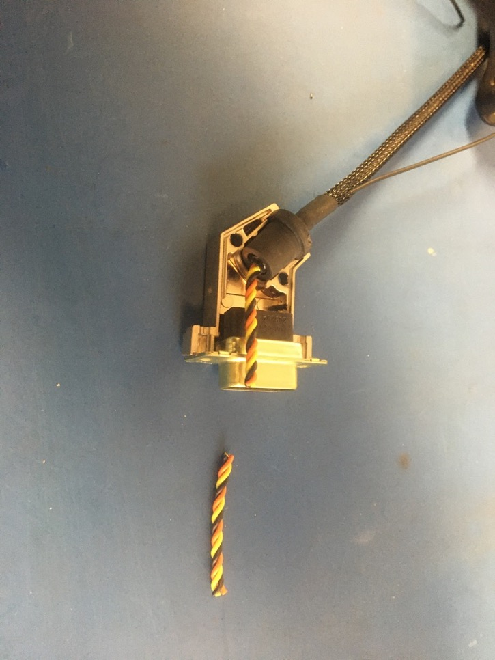
Place the D-sub shell stop into the bottom of the D-sub shell as shown. Put the 9 pin male D-sub connector into the bottom of the shell. Measure out and cut the twisted pairs so that they end at the mouth of the connector.

Slide 27
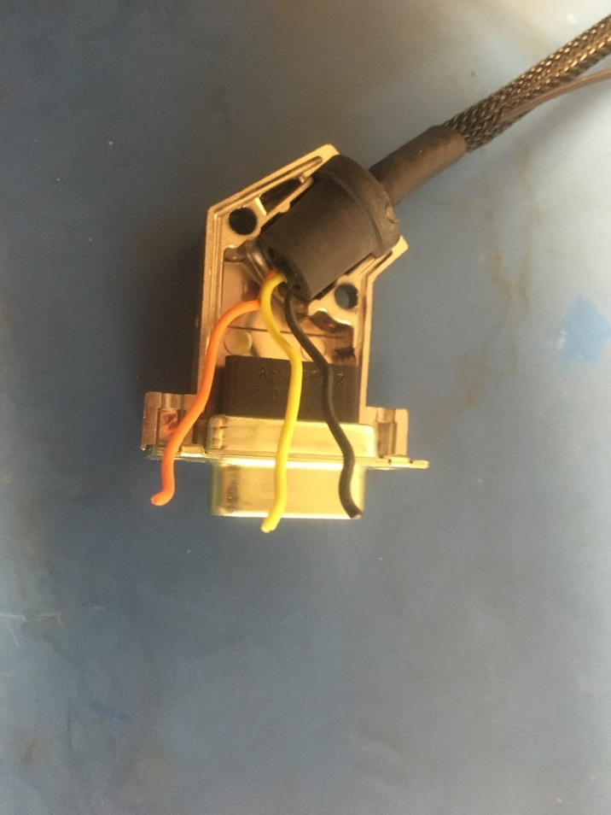
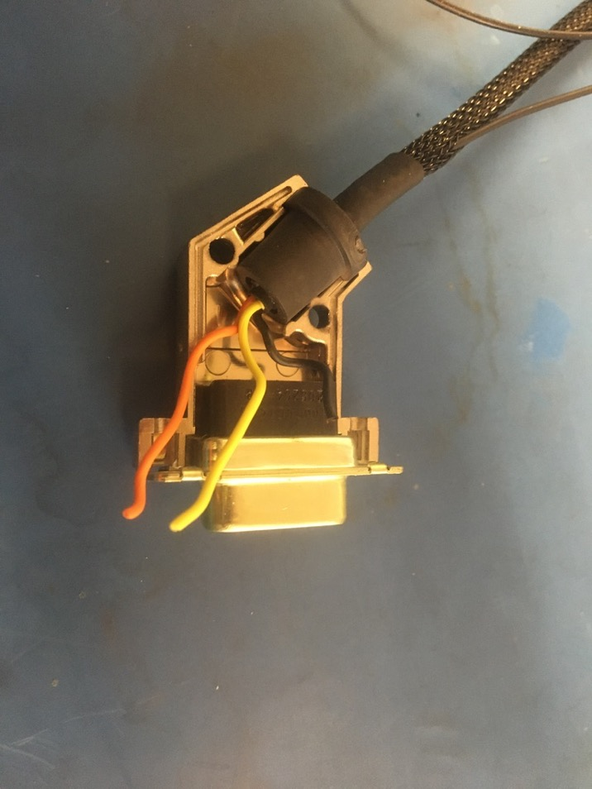
Untwist and straighten the twisted triplet. Position the black wire a shown on the right and trim it so it ends midway through the black part of the connector.

Slide 28
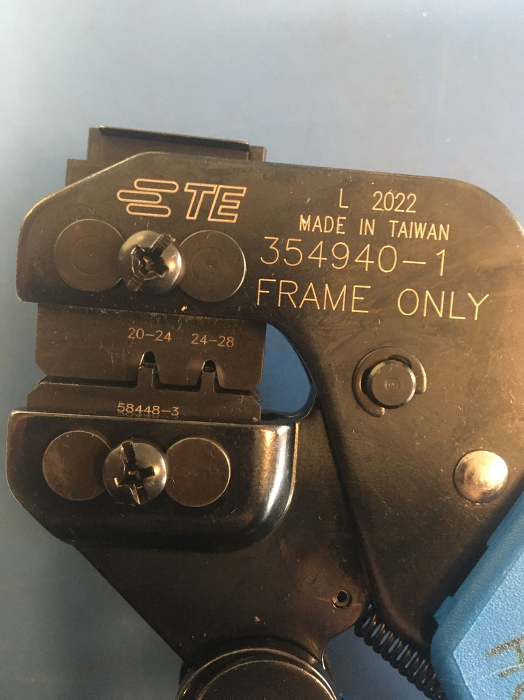
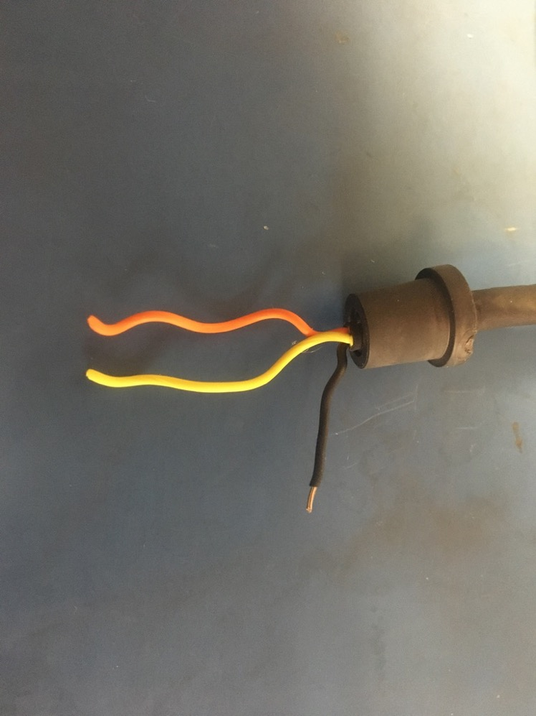
Strip about 2-3mm off the black wire. On this end of the harness, all the crimps will be done with the D-sub crimper and the 24-28 awg setting.

Slide 29
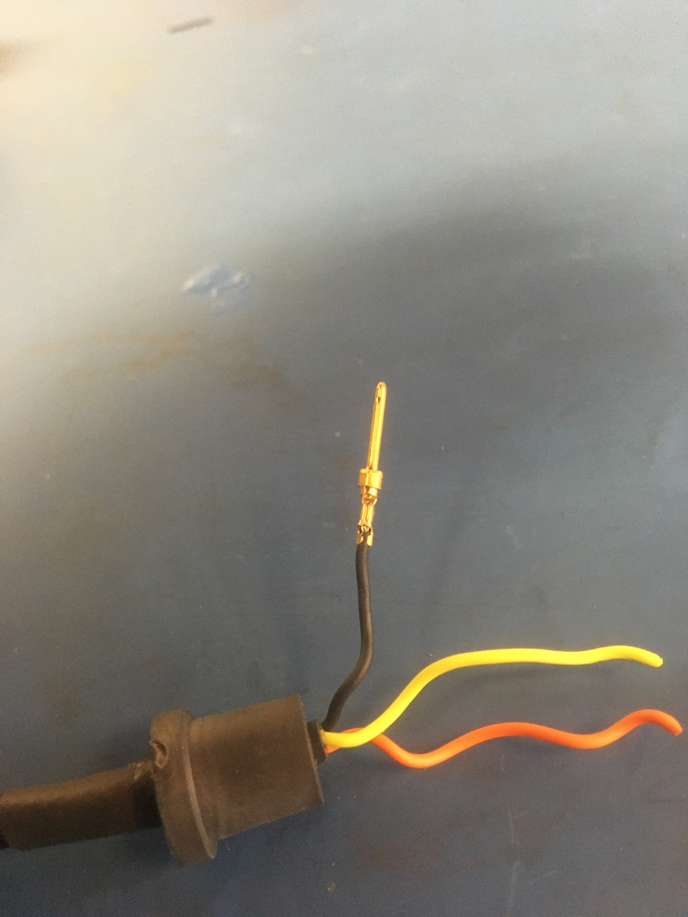
Exposed wire just visible
Crimp on a 24-28 D-sub pin onto the black wire. It should be crimped such that the isolation is held by the first grip but not the second. A bit of exposed wire should also be peaking out of the top of the second grip.
Isolation in first grip

Slide 30
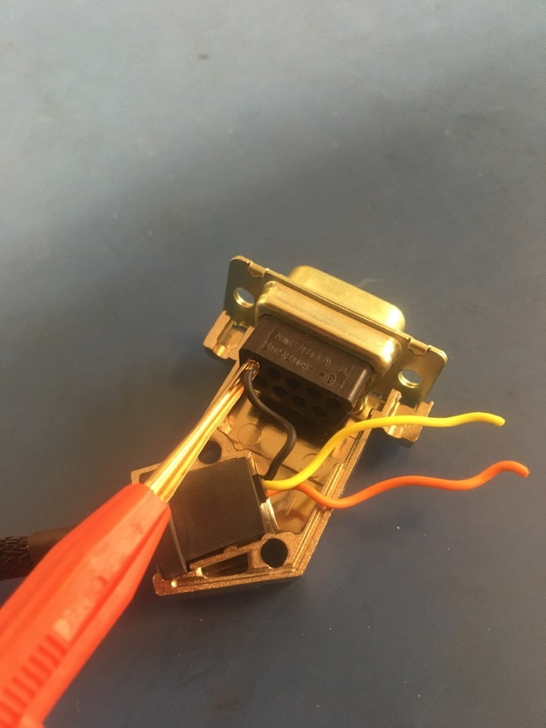
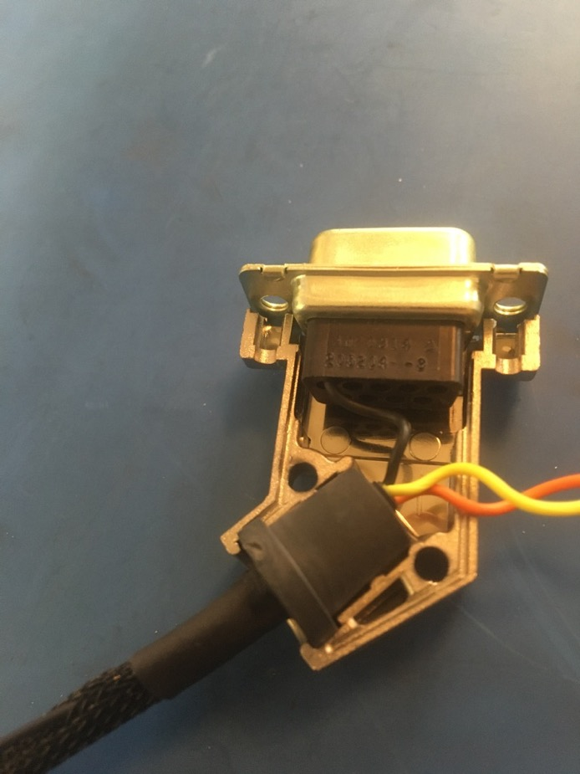
Insert the the black wire using the red end of the D-sub insertion/extraction tool. The pin should feel to click once inserted all the way. Please reference the accompanying pin out document to see where each wire should go.

Slide 31
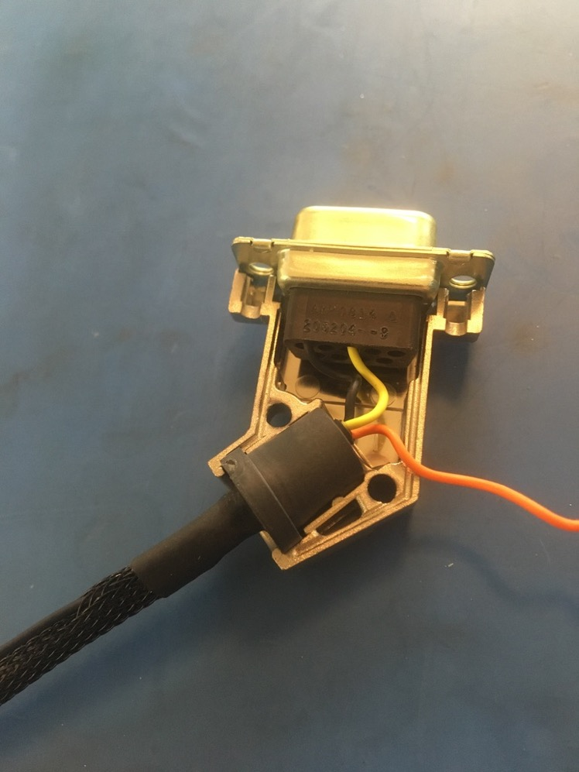
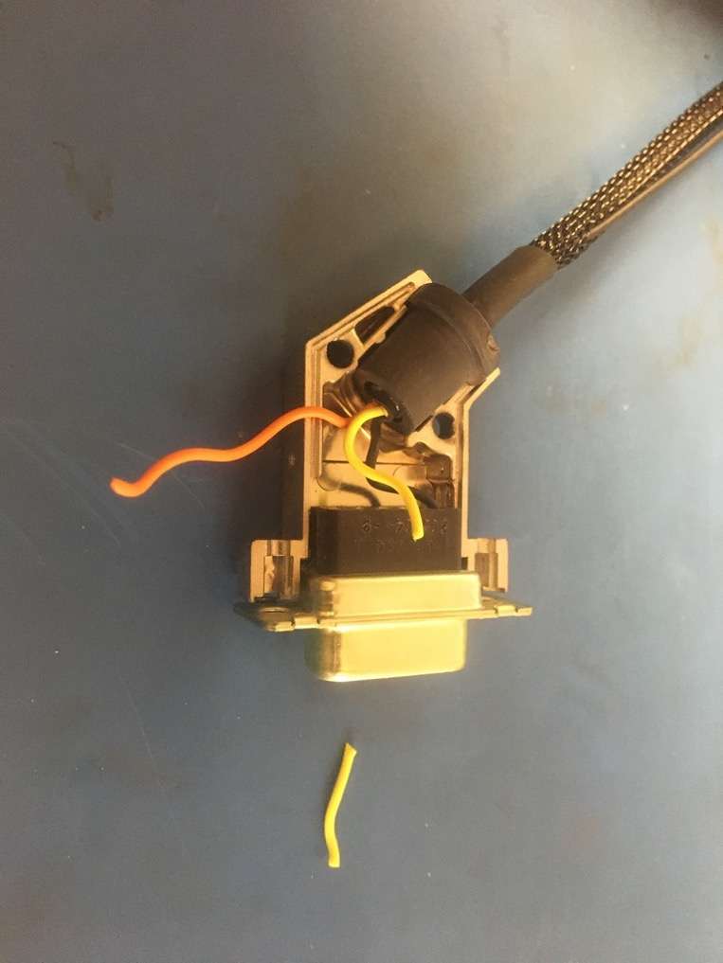
Position the yellow wire as shown on the left and trim it so it ends midway through the black part of the connector. Strip, crimp, and insert the yellow wire as previously exampled by the black wire.

Slide 32
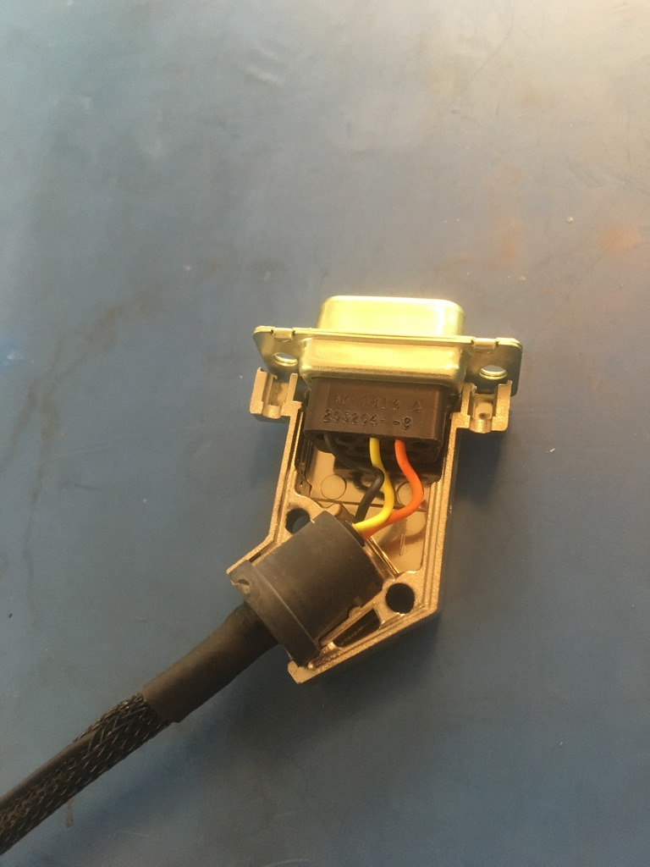
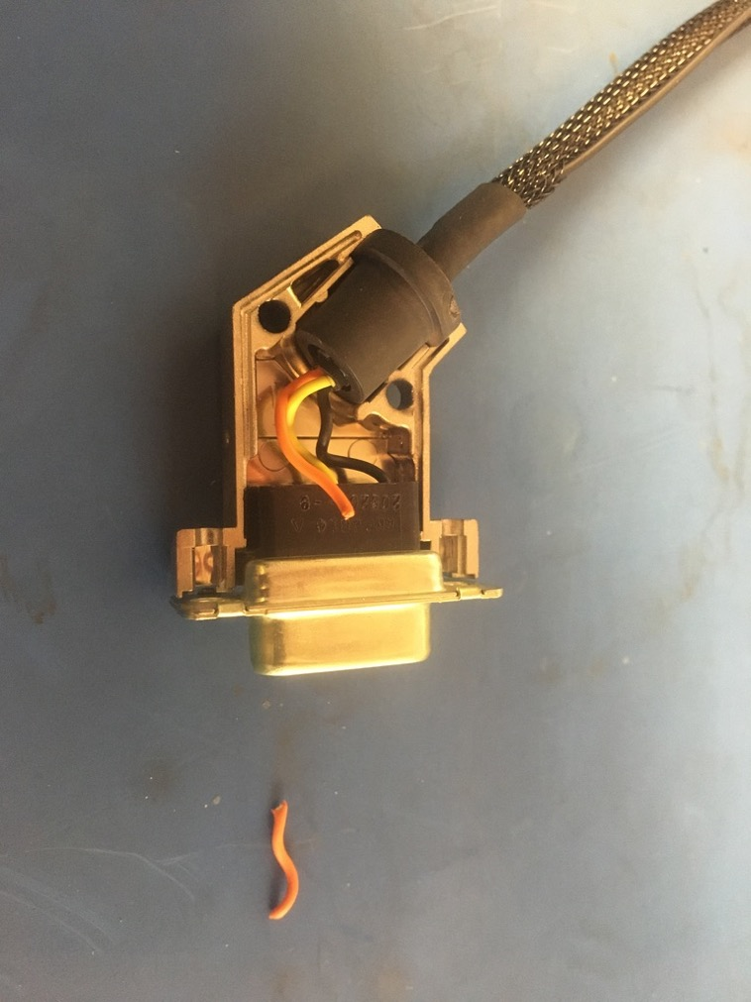
Position the orange wire as shown on the left and trim it so it ends midway through the black part of the connector. Strip, crimp, and insert the orange wire.

Slide 33
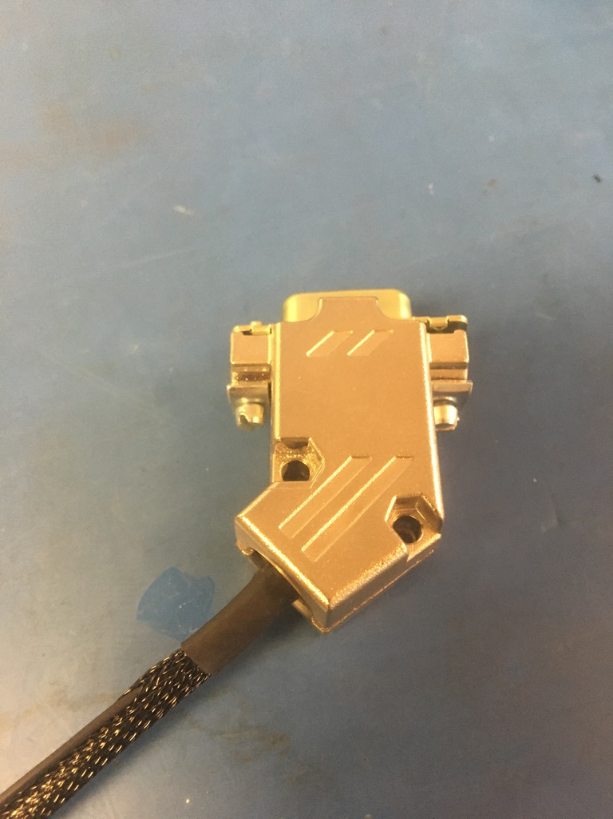
Place the top of the D-sub shell onto the bottom and put the connector screws and washers in.

Slide 34
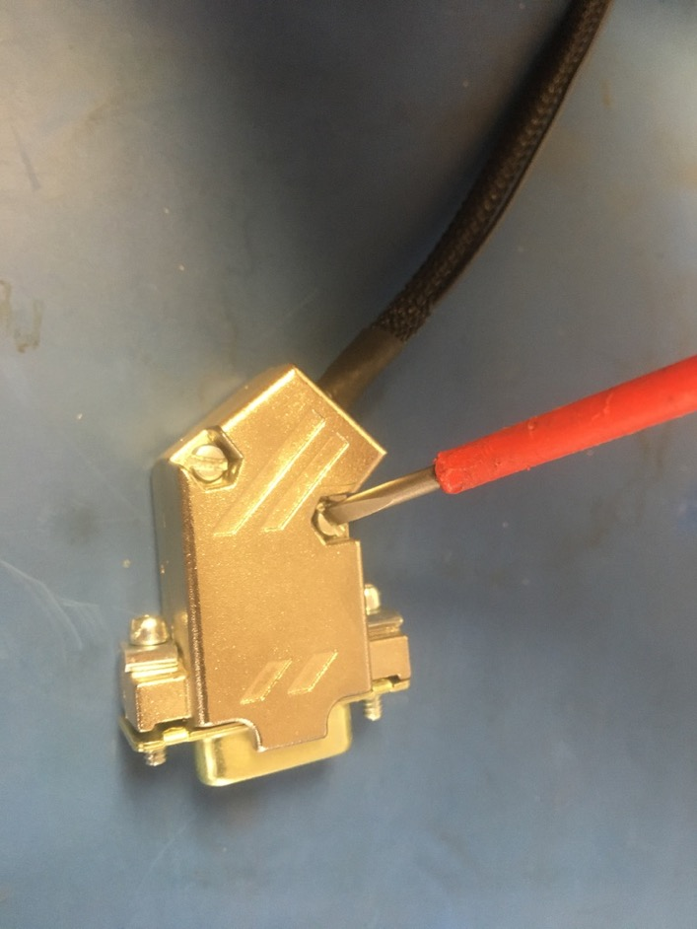
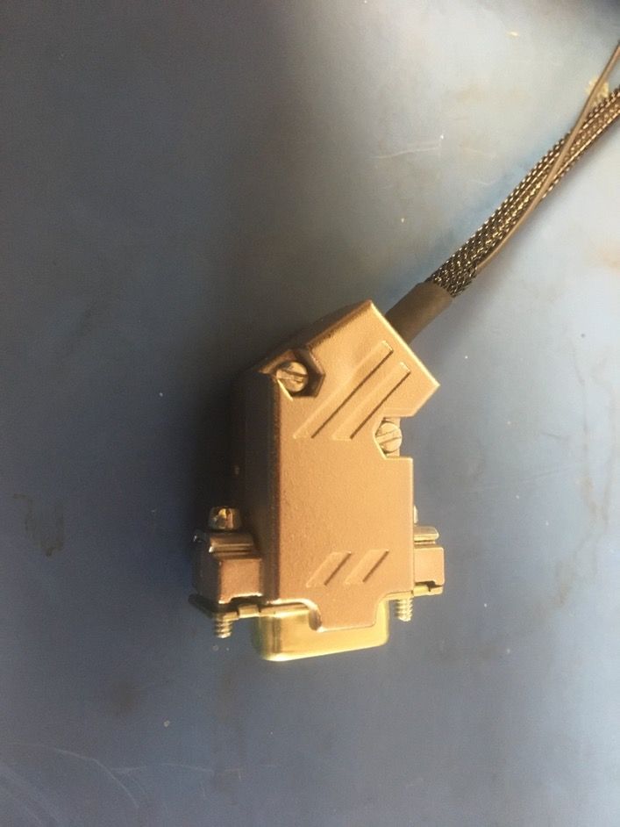
Close thr D-sub shell using the screws and nuts.

Slide 35


Now take the end without the D-sub shell and untwist about 1.25 inches of the triplet. Then trim the untwisted length so that it now measures .5in.

Slide 36


Strip the wires for the MIL spec pins. They should be stripped so that the exposed wire ends at the narrow orange stripe of a MIL spec pin as shown on the left.

Slide 37

Crimp the MIL spec pins onto all three wires using the MIL spec crimper.

Slide 38

Wire harness complete! The ground wire will be given a tip later.

